Slide 1
Prescriptive Analytics Capstone Project: Group 2
Navya Bhatia
Mya Stewart
Mrudhvika Sirineni
Joane Sarfati
Natalie Avina
Notes:
navya

Slide 2



AGENDA
01
Problem Overview and Data
02
Optimization Framework
03
Client C103 Case Study
04
Results and Trade-off Analysis
05
Sensitivity Analysis and Recommendations
06
Conclusion
Notes:
navya

Slide 3
Problem Overview and Data
Challenges:
Rising transportation costs
Urban traffic congestion
Carbon emissions from delivery operations
Increasing customer demand for fast deliveries
Environmental regulations in low-emission districts
01
GreenCity Logistics is seeking to create a more sustainable urban delivery network while maintaining reliable customer service.
Notes:
navya

Slide 4

Our project focused on helping GreenCity Logistics:
Reduce total operating costs
Reduce environmental impact
Maintain delivery reliability
Improve network efficiency
Meet customer service requirements
What Were We Trying to Achieve?
Notes:
navya

Slide 5
Understanding the Data Network
We analyzed five key sources of information:
Potential fulfillment center locations
01
Key Insight
02
Customer demand zones
Combining these datasets allowed us to evaluate cost, sustainability, and service performance simultaneously.
03
Vehicle fleet options
04
Travel distances and times
05
Environmental restrictions and emissions requirements
Notes:
navya

Slide 6
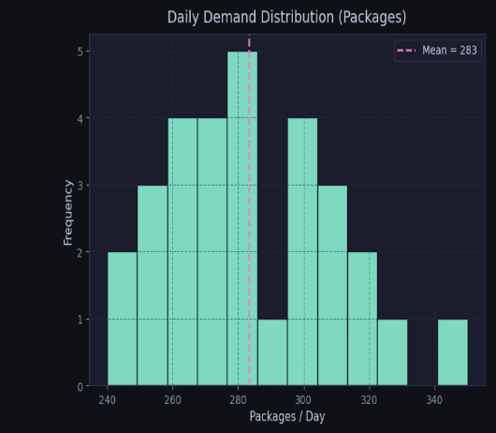
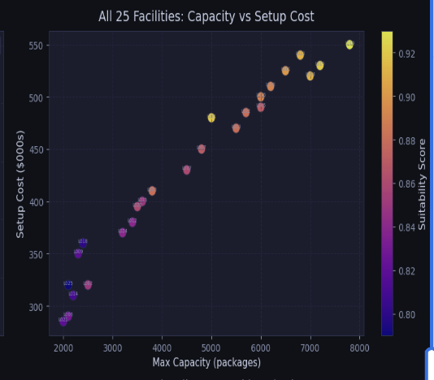
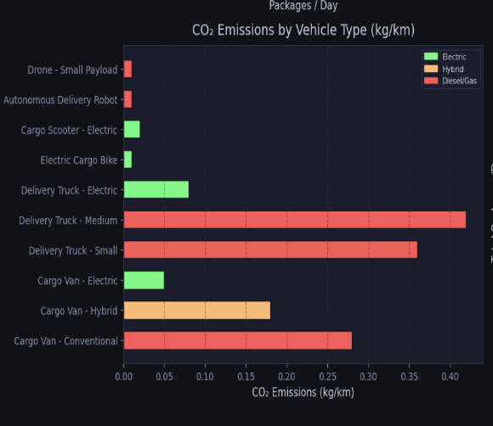
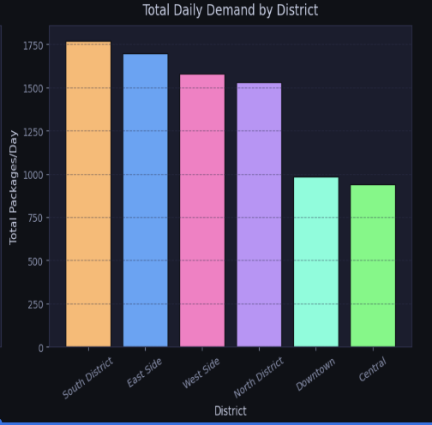
Understanding the Data Network
Notes:
navya

Slide 7
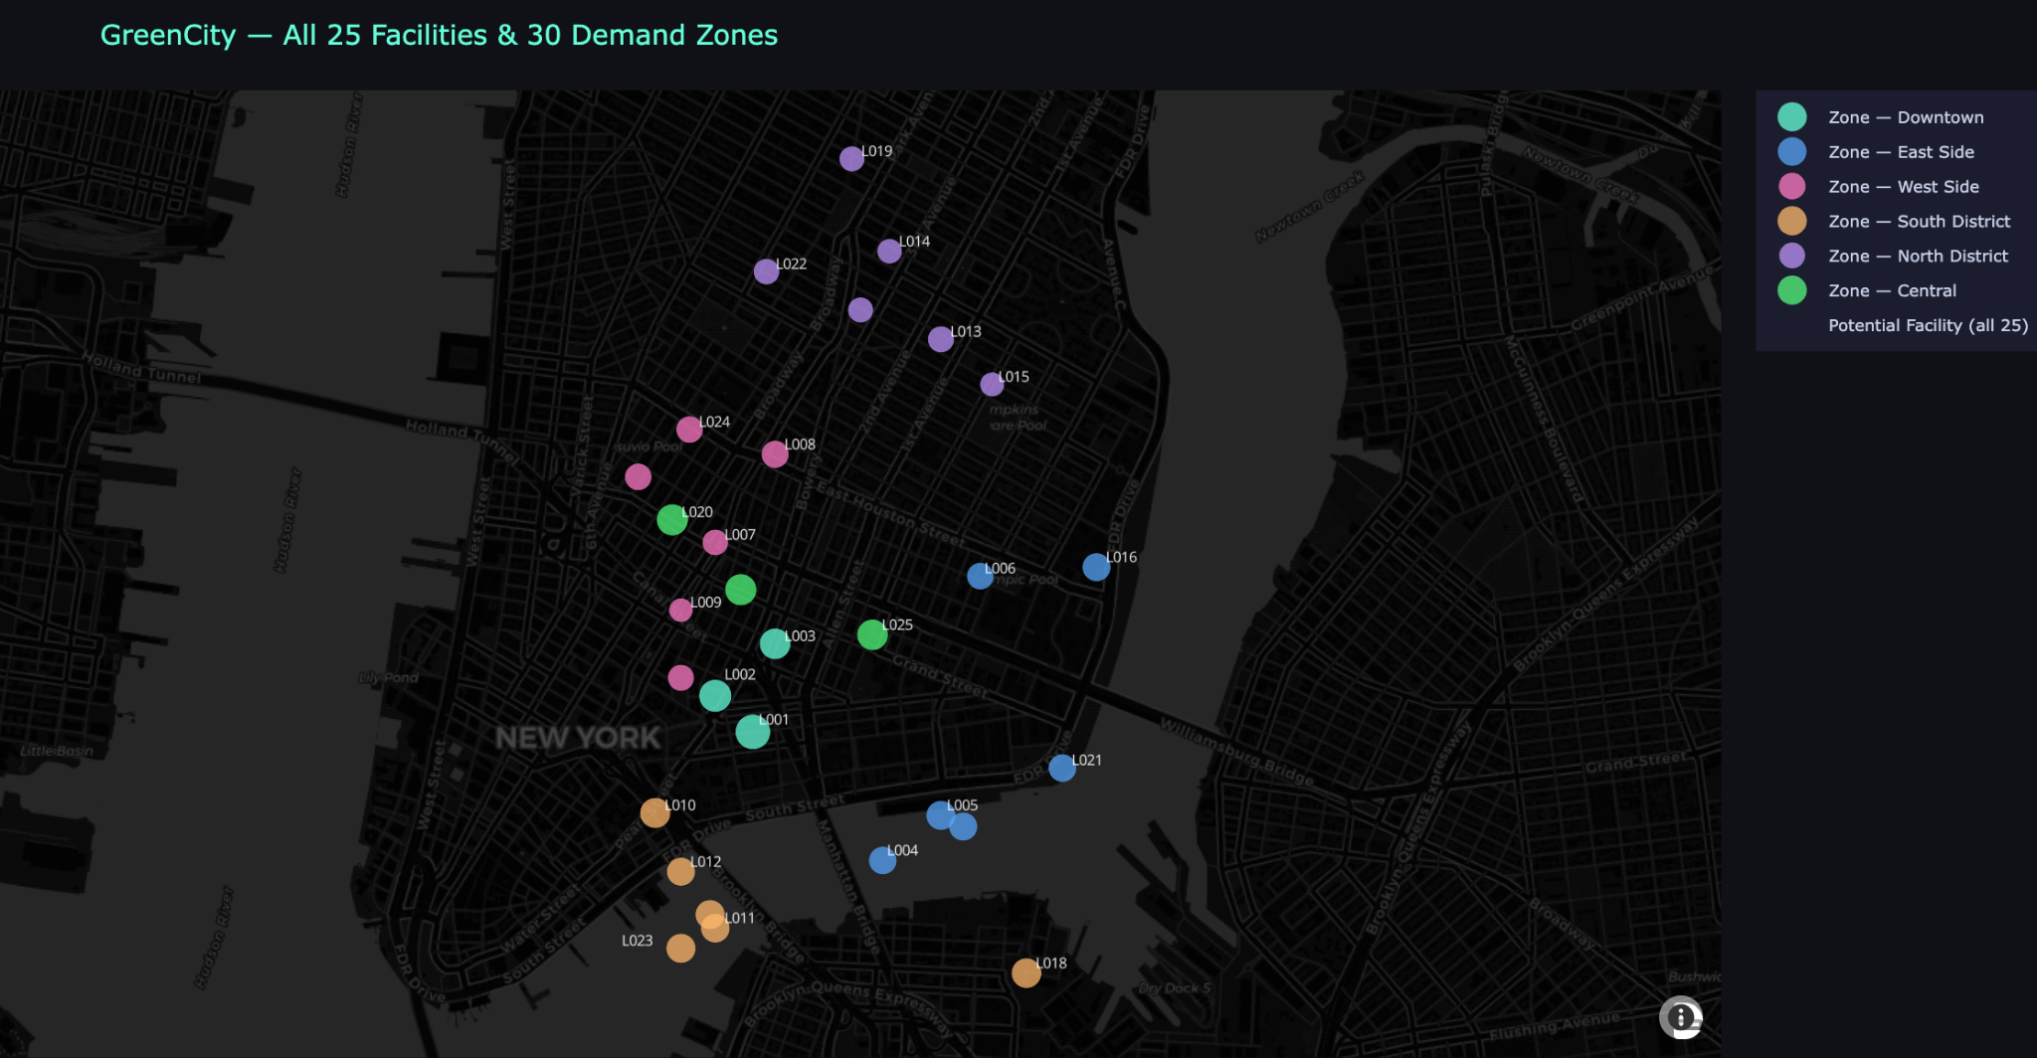
02
Optimization Framework
Which fulfillment centers should operate?
Which customer zones should each facility serve?
Which vehicles are best for each area?
How can emissions be reduced without sacrificing service?
Our Approach:
Facility Decisions
Delivery Decisions
Vehicle Decisions
Sustainability Decisions
Notes:
navya

Slide 8
Understanding Demand Across the City
Demand is concentrated in several high-density zones
Customer zones naturally form four demand clusters
High-demand regions may justify dedicated fulfillment support
Geographic clustering improves delivery efficiency
Notes:
navya

Slide 9
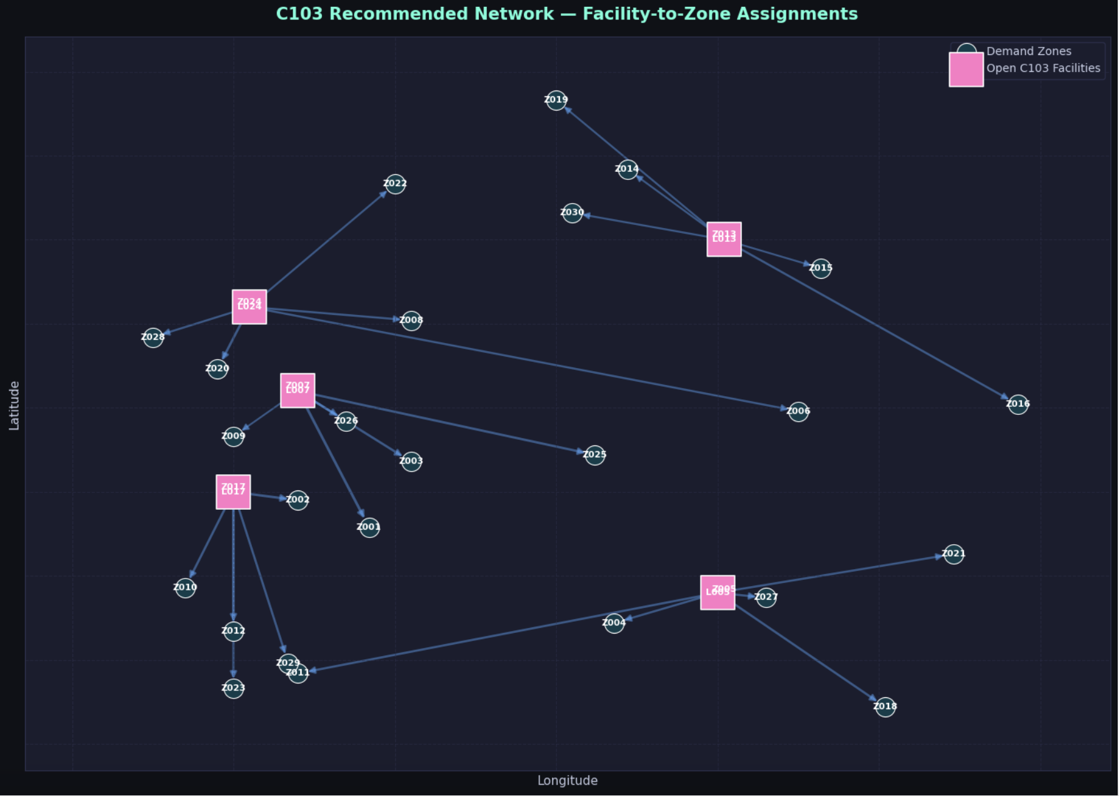
Recommended Network Configuration
Five fulfillment centers selected, each servicing 6 zones–all 30 zones are serviced
Customer demand successfully allocated
Capacity constraints satisfied
Service requirements maintained
Emissions requirement fulfilled
Notes:
Natalie

Slide 10
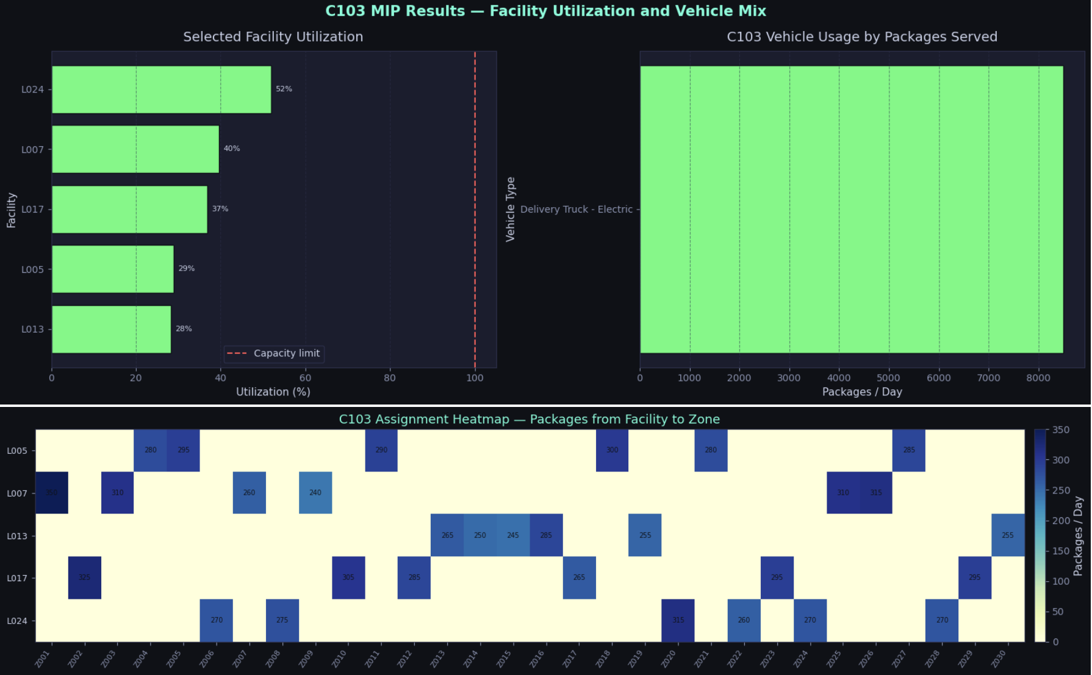
Client C103 Case Study
03
C103 MIP Results:
Well under capacity limits
All Electric Delivery Truck Fleet
Full service coverage
Notes:
Natalie

Slide 11
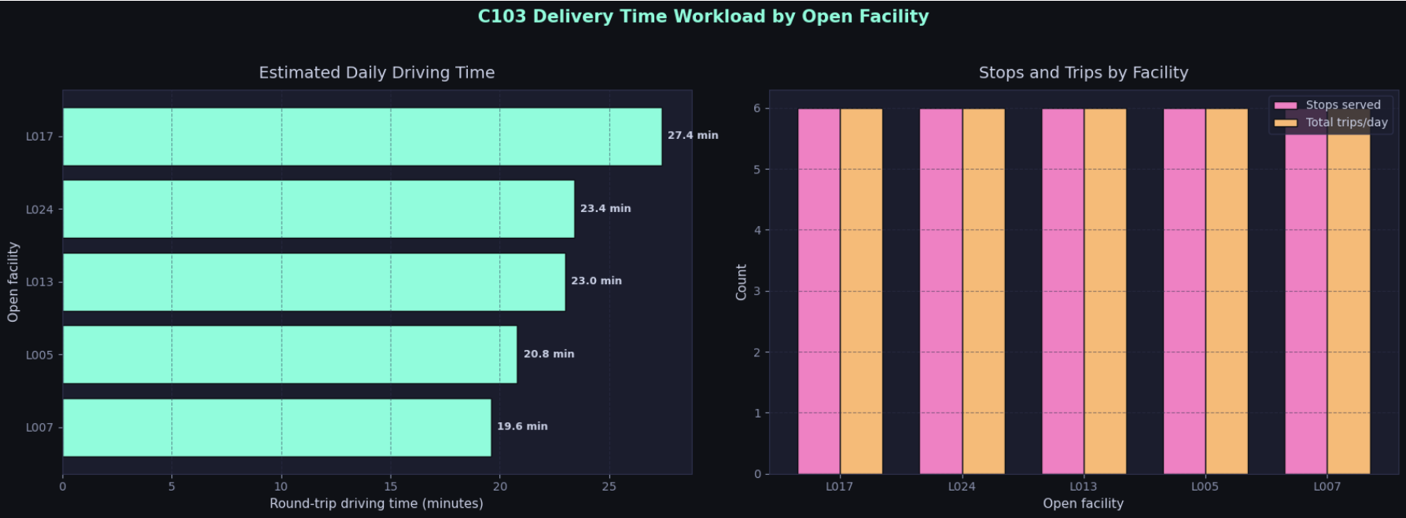
Client C103 Case Study
03
C103 MIP Results:
Estimated driving time is significantly less than 120 minutes
Six stops per trip, which meets the requirements.
Notes:
Natalie

Slide 12
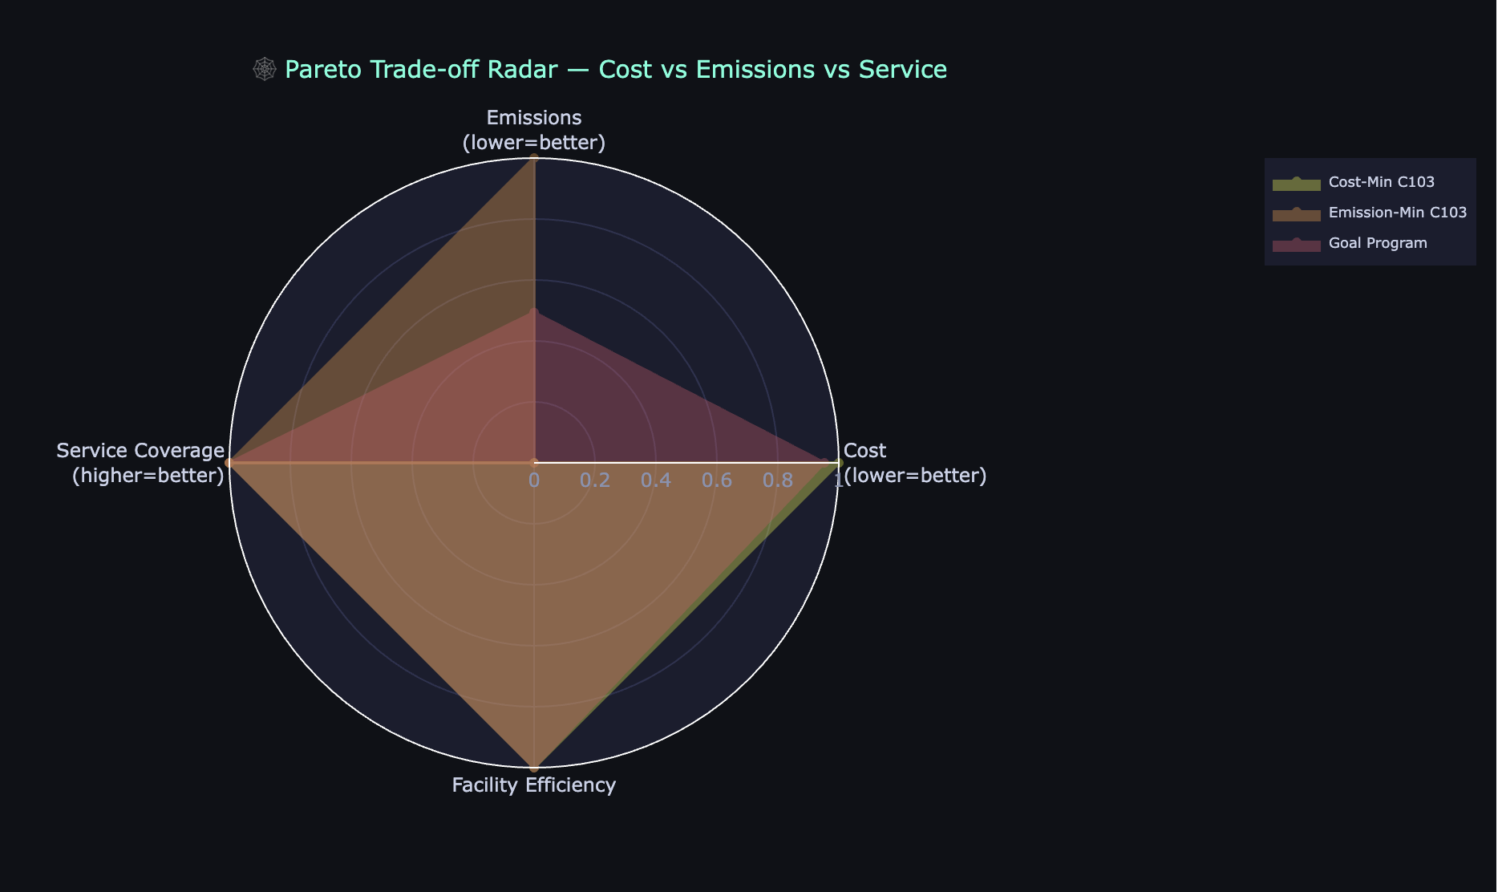
Trade-Off Analysis
Pareto Frontier
Shows:
Cost Minimizing Solution ⭐
Goal Programming Solution
Emission Minimizing Solution
Key Trade-Off
Balancing:
Cost
Emissions
Service Coverage
Facility Efficiency
Notes:
Mya

Slide 13
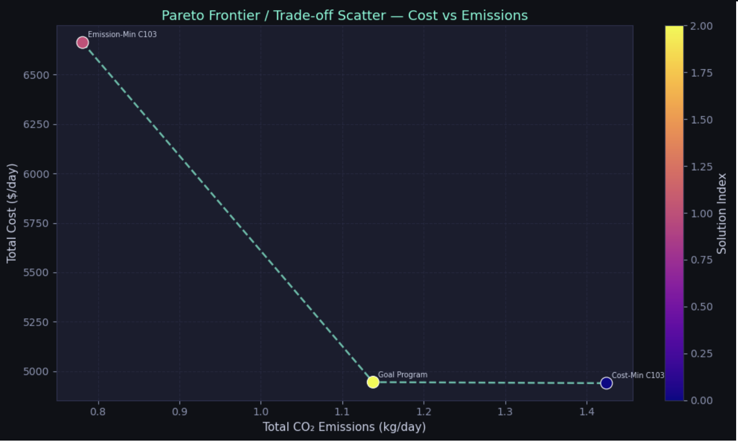
Alternative Solutions
Lower emissions generally increase cost
Lower cost may reduce sustainability performance
Management priorities influence the preferred solution–GP solution is best alternative
Our recommendation is still Cost-Minimizing solution
Notes:
Mya

Slide 14
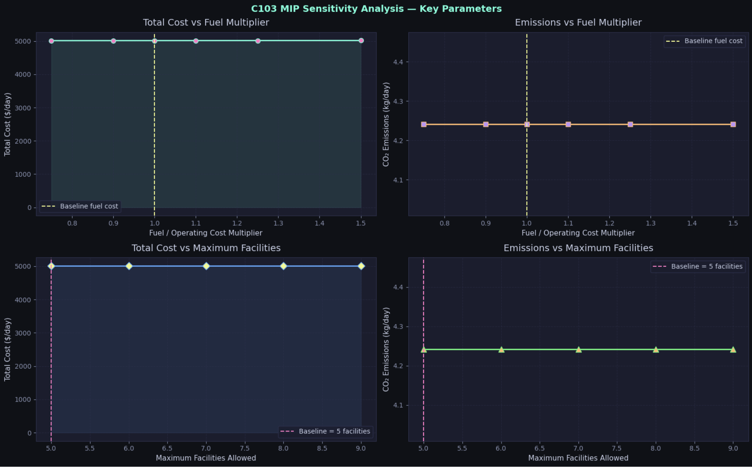
Sensitivity Analysis
Tested fuel cost multipliers (0.75x - 1.5x baseline)
Evaluated maximum facility availability limits
Re-optimized the MIP model for each scenario
Measured impacts on cost and CO2 emissions
Notes:
Mrudhvika
To test the reliability of our optimization model, we conducted a sensitivity analysis on two key parameters. First, we varied the fuel and operating cost multiplier, ranging from 75% to 150% of the baseline value. Second, we adjusted the maximum number of facilities that could be opened, testing different availability limits.
For each change, we re-ran the mixed integer programming model and recorded the resulting total cost and CO₂ emissions. The purpose of this analysis was to determine whether small changes in business assumptions would significantly impact the recommended network design.

Slide 15
Sensitivity Analysis Continued…
Cost remained stable across all tested scenarios
Co2 emissions showed no significant change
Facility selection remained unchanged
Results demonstrate a highly robust network design
Notes:
Looking at the results, we can see that the model remained remarkably stable across all tested scenarios.
In the top two graphs, changing the fuel cost multiplier had virtually no impact on either total cost or CO₂ emissions. The lines remain flat across the entire range, indicating that transportation costs were not a major driver of the optimal solution.
Similarly, in the bottom graphs, increasing the maximum number of facilities allowed did not change the total cost or emissions. The model consistently selected the same facility configuration regardless of how many additional facilities were made available.
This tells us that our recommended network design is highly robust. Even when important assumptions are adjusted, the optimization produces the same overall solution, giving decision makers greater confidence in the results.

Slide 16
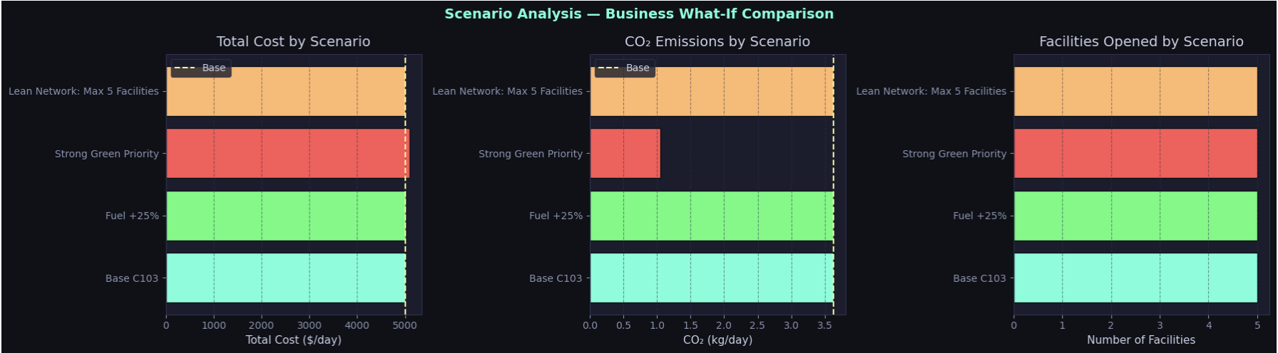
Scenario Analysis
Compared baseline and alternative business scenarios
Tested Fuel +25%, Green Priority, and Lean Network conditions
Evaluated cost, emissions, and facility utilization
Identified tradeoffs between sustainability and cost
Demonstrated strong operational resilience
Notes:
Mrudhvika
After testing individual parameters, we evaluated the model under several broader business scenarios to understand how it would perform under different operating conditions.
The scenarios included the baseline network, a fuel cost increase scenario, a strong green priority scenario focused on reducing emissions, and a lean network scenario that limited facility expansion.
The charts compare total cost, CO₂ emissions, and the number of facilities opened for each scenario.
The baseline and fuel increase scenarios produced nearly identical results, further confirming the stability observed in the sensitivity analysis. The lean network scenario also maintained similar performance while operating with fewer facilities.
The strongest change occurred in the green priority scenario. Emissions were reduced substantially, but this came at the expense of higher total costs and a larger facility footprint. This demonstrates the tradeoff between sustainability goals and operational efficiency.
Overall, the scenario analysis shows that the network performs consistently under different business conditions while still allowing management to prioritize either cost efficiency or environmental sustainability depending on organizational goals.

Slide 17
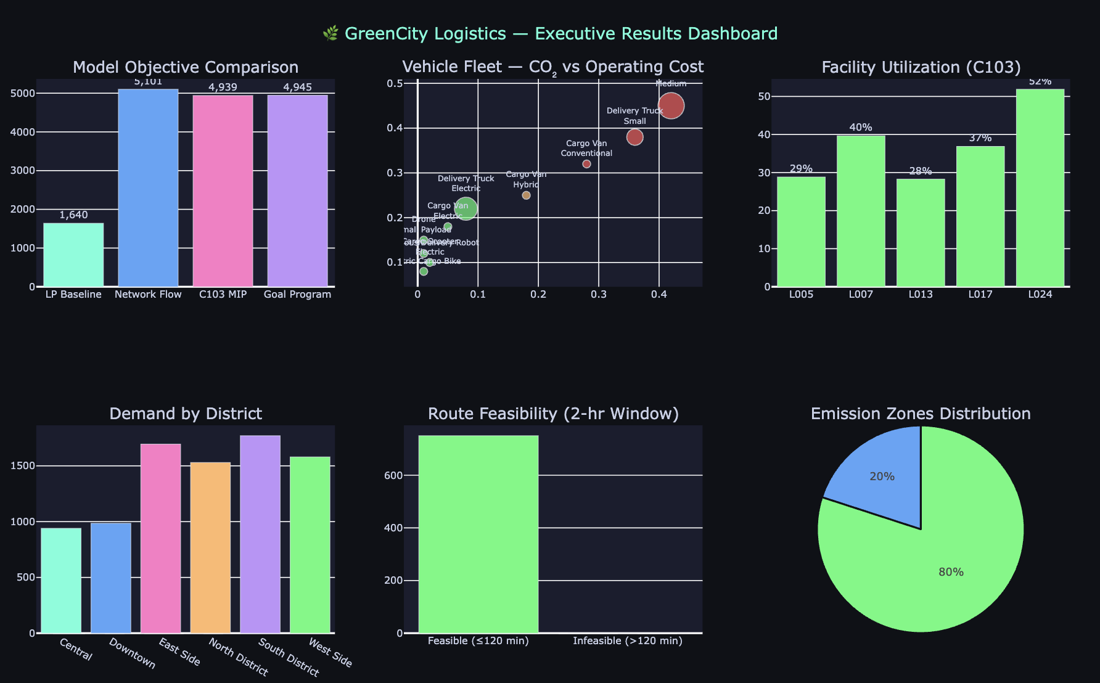
Executive Insights Dashboard
Notes:
Joane: To summarize the key findings of our analysis, this executive dashboard brings together the most important performance indicators from the project. The results show that the optimized network achieves full service coverage while maintaining low operating costs and meeting sustainability objectives. The recommended solution operates with five strategically selected fulfillment centers and an all-electric vehicle fleet. Facility utilization remains balanced across the network, customer demand is fully satisfied, and all deliveries remain within the required service window. Overall, the dashboard demonstrates that GreenCity Logistics can successfully balance cost efficiency, operational performance, and environmental responsibility through data-driven decision making.

Slide 18
Final Recommendations
Operational
Operate the optimized 5-facility network using locations L005, L007, L013, L017, & L024
Maintain current full-service coverage strategy
Sustainability
Expand to fully electric vehicle deployment
Continue compliance with low-emission zones
Future Improvements
Expand route dataset
Incorporate real-time traffic data
Evaluate additional sustainability targets
Notes:
Joane:Based on our optimization, sensitivity analysis, and scenario testing, we have three primary recommendations. First, from an operational perspective, GreenCity Logistics should implement the optimized five-facility network using locations L005, L007, L013, L017, and L024 while maintaining full service coverage. Second, from a sustainability perspective, the company should continue expanding its electric vehicle fleet and maintain compliance with low-emission zone regulations. Finally, for future improvements, we recommend incorporating additional route data, integrating real-time traffic information, and evaluating more advanced sustainability targets. Together, these actions will help the company remain cost-effective, environmentally responsible, and scalable as demand continues to grow.

Slide 19

THANK YOU
Notes:
In conclusion, our project demonstrates how prescriptive analytics can help organizations make smarter operational decisions while balancing cost, service quality, and sustainability goals. Through optimization modeling, trade-off analysis, and scenario testing, we developed a robust and practical solution for GreenCity Logistics. Thank you for your time and attention. We would be happy to answer any questions.

